Slide 1
Introduction to Programming with Python
Lev Tauz and Noor Nakhaei
PhD Students, CS and ECE
levtauz@ucla.edu,
noornk@ucla.edu
Dr. Ankur Sarker, Postdoc, ECE
ankursarker@ucla.edu
July 12-13, 2020 Note: modified from original LACC slides by Prof. Lucas Wanner, Prof. Mani Srivastava, Dr. Mark Gottscho,
Dr. Bharathan Balaji

Slide 2


Welcome to LACC 2021 @ UCLA!
Introductions
Name?
High school?
Favorite activity outside school?
Something interesting or different about you?
What excites you about computing or engineering?

Slide 3
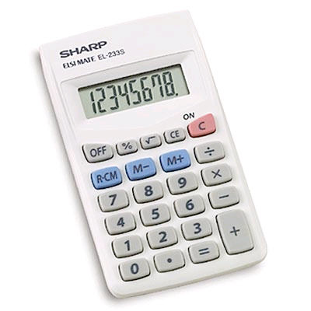
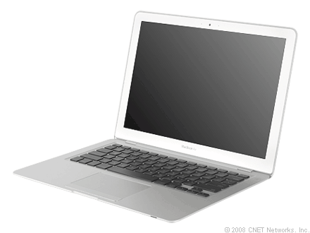
Introduction
What are the similarities and differences between a calculator and a computer?
The fundamental difference between a computer and a calculators that computers are programmable!

Slide 4
What does “programmable” mean?
A program is a “script” of operations stored in memory that tells a computer what to do.
Think of a program as a recipe for solving a problem. It’s a step-by-step procedure.
A calculator can...
perform arithmetic operations
perform logic operations
store values in memory
load values from memory
A computer can...
perform arithmetic operations
perform logic operations
store values in memory
load values from memory
Unlike a calculator, a computer can make choices about what to do.
These are made using branches and loops in a procedure.
Essentially, decisions on what computation to do based on a condition.

Slide 5
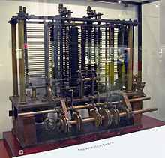
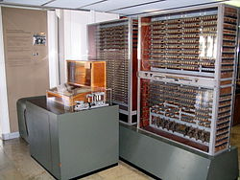
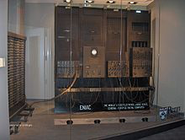
A Bit of History: Who invented the programmable computer?
Charles Babbage originated the concept of and designed a mechanical programmable computer in 1837 called the “Analytical Engine”, but couldn’t finish it as the British Government ceased funding.
The first programmable computers were not actually built until ~ 1940 using electromechanical relays (by German engineer Konrad Zuse)
World's first electronic digital programmable computer (using vacuum tubes) was built by Eckert and Mauchly at U. Penn, but invention attributed to Atanasoff of Iowa State
Reconstruction of Babbage's Analytical Engine, the first general-purpose programmable computer.
Replica of Zuse's Z3, the first fully automatic, digital (electromechanical) general-purpose programmable computer.
ENIAC, the first electronic general-purpose computer

Slide 6
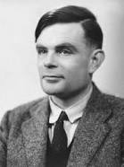

History: Alan Turing
British mathematician and a father of computer science: helped crack German encryption in WW2 using the Enigma computing machine
Invented a hypothetical computing machine called the “Turing Machine” that helped formalize the theoretical limits of mechanical computation or algorithms, i.e. what sorts of things can be computed
Universal Turing Machine == A Turing Machine that is able to simulate any other Turing Machine
Every real-world computer can be simulated by a UTM
A real world computer or a programming language is called “Turing Complete” if it can simulate a UTM, or equivalently compute anything that can be computed

Slide 7
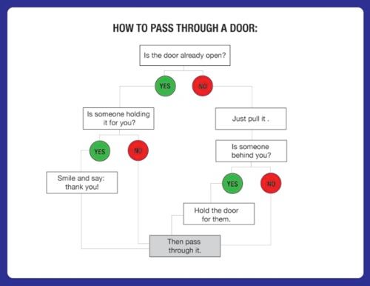
Conditional Branches
“A decision on which path to take based on some condition”

Slide 8
How can we express a program?
Using real machine code (binary)?
1: “on” 0: “off”
… 10101001000000101011111 0010101 00011 10100101001 0100 100100100 0000000000 …
How do we humans do anything with this? Surely a better way…
Code comments — human-readable
explanations that don’t do anything in the program
How about machine language
(assembly code) instead?
pass_door:
ld register_1, door_status
ld register_2, door_open
beq register_1, register_2, holding
call pull_door
holding:
...
pull_door:
...
# load contents from memory into register
# if register 1 and 2 are
equal, go to (branch to) label “holding”

Slide 9
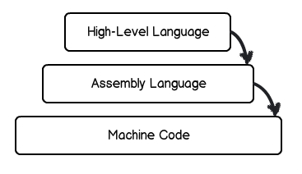
Can we do better still?
We actually code in high-level, human-readable programming languages
Allow us to express programs in a way that is closer to natural languages
Provide libraries of commonly-used sub-tasks (functions)
Translate high level code into machine code through compilers or interpreters
Given a language providing…
function definitions and calls, f(x)
a library function, print(“text”)
comparisons, x == y
assignments, x = y
conditional statements, if (condition) ... else …
…how can we write the “pass door” program?
Ref: http://shawnbiddle.com/js101/slides/class1.html#/6

Slide 10
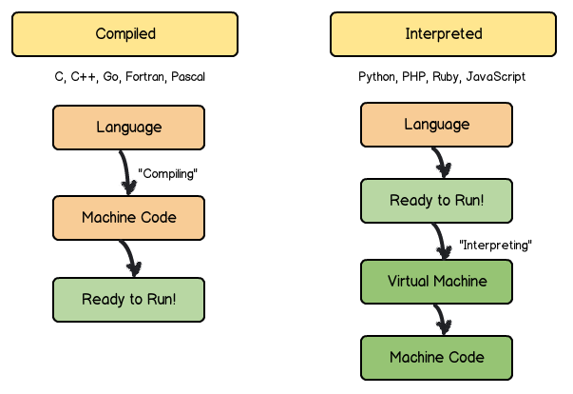
Compiled vs. Interpreted Programs
Ref: http://shawnbiddle.com/js101/slides/class1.html#/10

Slide 11
Part of the “Pass door” program in “Pseudocode”
function pass_door()
if (door_status == door_open)
if (hold_status == someone_holding)
print(“Thank you”)
else
pull_door()
# function definition
# conditional statements,
comparisons
# call library function
# call function
function pull_door()
door_status = door_open
...
# assignment of value to variable

Slide 12
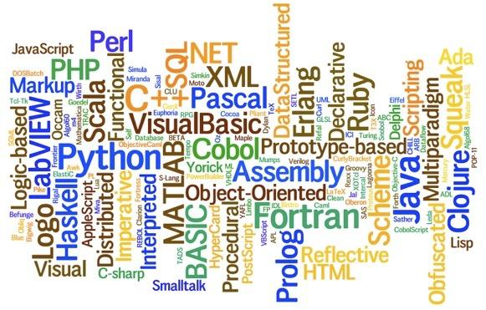
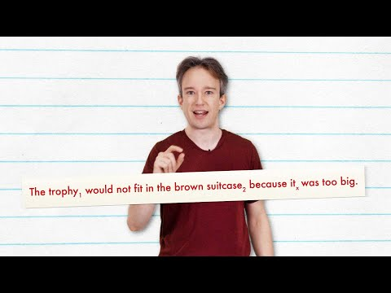
Programming in Python
Why can’t we program in English?
Why do we need so many programming languages?
Why Python?

Slide 13
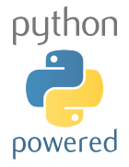
Why do we choose Python?
Relatively simple syntax.
Relatively easy to debug.
Availability of open-source tools and modules/libraries for eclectic applications with large development community.
Platform agnostic (runs anywhere).
Broad application spectrum, e.g. web applications / frameworks, standalone applications, video games, data science, artificial intelligence, machine learning, embedded systems etc.
Notes:
Show the Python’s advantages. Compare them with English to make Python more familiar to students.

Slide 14

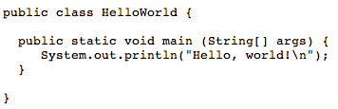
How simple is Python?
To print “Hello world!” on screen, C, Java and Python need to do:
C:
Java:
Python:
Notes:
Compare C, Java and Python’s ways to print “Hello world!”. This proves that Python gives the simplest way to print it.

Slide 15





Find Python around you
Python is used everywhere!
Web applications (server side):
YouTube
Facebook
Dropbox
Pinterest
MoinMoin, a popular wiki engine
Notes:
Show the web applications in Python.

Slide 16



Find Python around you
Python is used everywhere!
Applications (client side):
Original BitTorrent client, along with several derivatives
Ubuntu Software Center, a graphical package manager
Dropbox (desktop application)
Mercurial
Notes:
Show the applications written in Python.

Slide 17
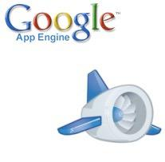

Find Python around you
Python is used everywhere!
Web frameworks:
Google App Engine
Django
Notes:
Show the web frameworks written in Python.

Slide 18


Find Python around you
Python is used everywhere!
Video games:
Civilization IV
Battlefield 2
Notes:
Show the video games written in Python.

Slide 19
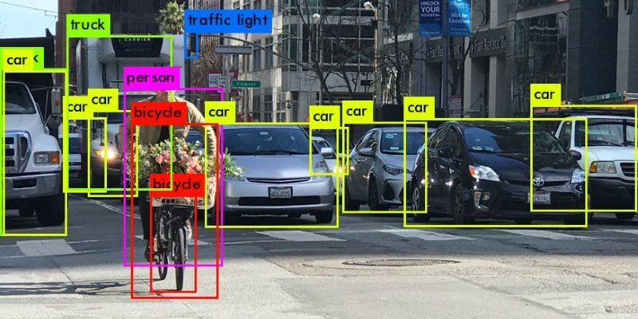


Find Python around you
Python is used everywhere!
Machine Learning:
Pytorch
Tensorflow
Notes:
Show the video games written in Python.

Slide 20
Getting Python
Python Official Website: http://www.python.org
Lots of “packages” that add capabilities to the basic language and “tools” that make writing, running, and debugging easier
Free and commercial “distributions” that bundle core Python with useful packages and tools and simplify installation, e.g.
Anaconda: https://store.continuum.io/cshop/anaconda/
Enthought Canopy: https://www.enthought.com/products/canopy/
Browser-based Python (limited functionality)
http://www.tutorialspoint.com/ipython_terminal_online.php
http://www.tutorialspoint.com/execute_python_online.php
http://repl.it/languages/Python
http://pythonfiddle.com

Slide 21
Free Python Learning Material on the Web
Official Tutorial: https://docs.python.org/2/tutorial/
TutorialsPoint: http://www.tutorialspoint.com/python/index.htm
Google: https://developers.google.com/edu/python/
LearnPython: http://www.learnpython.org
Code Academy: http://www.codecademy.com/en/tracks/python
And many many more…

Slide 22
Jupyter Notebooks and Google Collab
Jupyter Notebook App is an application running inside the browser. It allows you to edit and run code via a web browser.
It is a document that contains code ( e.g. python) and text elements.
For this course, we will be using Jupyter notebooks with Google Collab.

Slide 23

Python Basics: Variables, Types & Operators
What is a Variable?
A variable is a place in memory, which has a name, and where you can store a value (a number, phrase, etc.).
Assigning Values to Variables:
Python variables are declared automatically when you assign a value to a variable.
The equal sign ( = ) is used to assign values to variables.
Values may be of different “types”
Common Data Types: int, str, float, bool, list, dictionary
Operators perform arithmetic and logical operations over variables and values.
Notes:
In computing, memory refers to the state information of a computing system, as it is kept active in some physical structure. By design, the term “memory” refers to temporary state devices, whereas the term “storage” is reserved for permanent data.

Slide 24
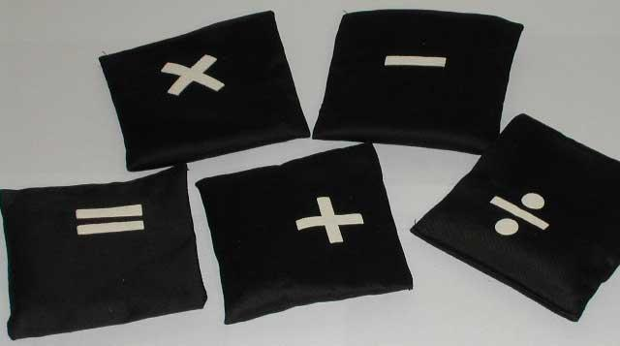
Python Operators
What is an operator?
Python operators are very similar to the mathematical operators we use everyday. For example, +, -, *…
Notes:
Introduce Python operators.

Slide 25
Python Basic Operators
Python Operator Types:
Arithmetic Operator
Comparison Operators
Logical (or Relational) Operators
Assignment Operator
Notes:
The basic python operator types.

Slide 26

Python Arithmetic Operators
Assume variable a holds 10 and variable b holds 20 then:
Addition | a + b = 30
Subtraction | a - b = -10
Multiplication | a * b = 200
Division | b / a = 2
Reminder | b % a = 0
Exponent | a ** b = 10²⁰
Notes:
Show how the arithmetic operators work with the examples in the table.

Slide 27
Python Arithmetic Assignment Operators
Assume variable a holds 10 and variable b holds 20 then:
Addition | a += b | a=30
Subtraction | a -= b | a = -10
Multiplication | a *= b | a = 200
Division | b /= a | b = 2
Reminder | b %= a | b= 0
Exponent | a **= b | a = 10²⁰
Notes:
Show how the arithmetic operators work with the examples in the table.

Slide 28

Python Comparison Operators
Assume variable a holds 10 and variable b holds 20 then:
Equality | a == b = False
Inequality | a != b = True
Less than | a < b = True
Greater than | a > b = False
Less than or equal | a <= b = True
Greater than or equal | a >= b = False
Notes:
Show how the comparison operators work with the examples in the table.

Slide 29
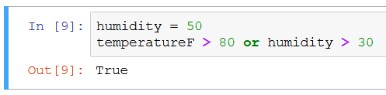
Python Logical Operators
Assume variable a holds True and variable b holds False then:
Logical AND | a and b = False
Logical OR | a or b = True
Logical NOT | not a = False
Notes:
Show how the comparison operators work with the examples in the table.

Slide 30
Python Data Types
In computer programming, a data type is a classification identifying one of various types of data, just like in real life we separate words “Hello!” and numbers “12345”.
Standard Data Types in Python:
Numbers, e.g., 1000
String, e.g., “Hello world!”
Boolean e.g. True or False
List, a container e.g., [365, 12, 30] or [“hi”, “every”, “body”]
Dictionary, a key-indexed container.
Notes:
We introduce the five standard data types in Python here. In the following slices, we will study them in more detail.

Slide 31
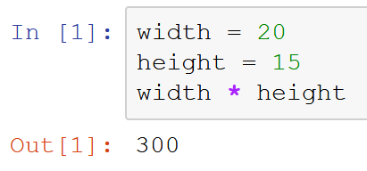
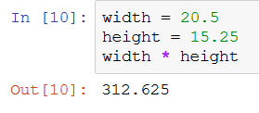
Python Types: Numbers
Numbers
Store numeric values,
Example:
In this example, “width = 20” defines variable width to be 20, and “height = 15” defines height to be 15. This sort of number is called integer or int.
After initializing width and height, we can calculate width * height as shown in the example.
To use real numbers (also called float / double),, add a dot:
Notes:
Provide an example for number variables.

Slide 32
Warm-up
Start up the Jupyter notebook
Do the “Warm-up” part (instructions included)
Feel free to ask questions

Slide 33
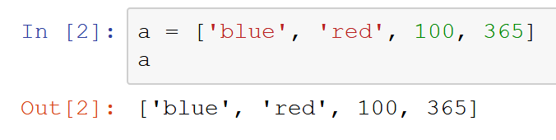
Python Types: Lists
Lists:
Lists are the most versatile of Python’s compound data types. A list contains items separated by commas and enclosed within square brackets.
Example:
In this example, we assign four items to list a. The items are string ‘blue’, string ‘red’, number 100, and number 365.
We print a’s items in the second command, and get its four items printed.
Note that items in the list have different types (string and int) – this is not common among programming languages.
Notes:
Show the concept of lists, and show an example.

Slide 34
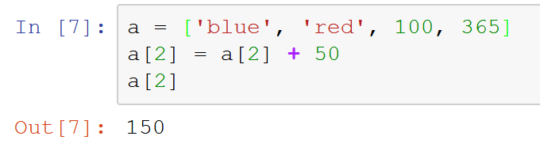
Python Types: Lists
Lists:
It is possible to change individual elements of a list.
Example:
In this example we modify the third element in the list by adding 50 to its value
We then print the third element by using name[index]
Note that list’s subscript starts from 0
Notes:
Another example for list variables.

Slide 35
Python Types: Lists
Lists:
Many “operations” and “methods” available for lists:
+ sort, concatenate, insert, sum and many more at: https://docs.python.org/2/tutorial/datastructures.html#more-on-lists
Is the value in the list? | 100 in a = True
Is the value not in the list? | ‘yellow’ not in a = True
Length of the list | len(a) = 4
Index of an element | a.index(‘red’) = 1
Append element | a.append(10)
Reverse the list | a.reverse()
Notes:
Another example for string variables.

Slide 36
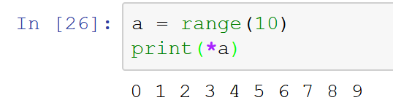
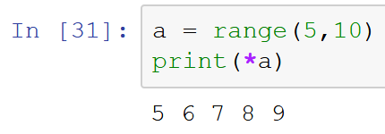
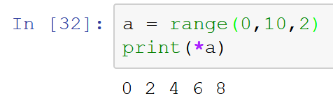
Python Types: Range
Creating number sequences:
range(n) for integer n > 0 returns the list [0, 1, … n-1]
range(m,n) returns the list [m, m+1, … n-1]
range(m,n,o) returns the list [m, m+o, … n-1]
Notes:
Another example for list variables.

Slide 37
Exercise # 1
Go to Exercise 1 section in your Jupyter Notebook
Given a list L = [2, 3, 4, 5, 6]
Print the second item in this list.
Get the sum of all the values in this list.
Append value 7 after value 6 into the list.
Using range, print all the even numbers from 4 to 12.
Look at https://docs.python.org/2/tutorial/datastructures.html#more-on-lists for various methods available for list data type

Slide 38
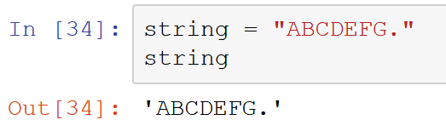
Python Types: Strings
Strings:
Strings in Python are identified as a contiguous set of characters in between quotation marks.
A String is a list of characters or char data types where each char specifies the symbol.
Example:
In this example, we assign “ABCDEFG.” to variable string. And we print string. The result we get is still “ABCDEFG.”
You can use double “ or single ‘ quotation marks for strings in Python, they are equivalent.
Notes:
Show the concept of strings, and show an example.

Slide 39
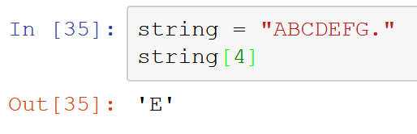
Python Types: Strings
Strings:
Strings can be subscripted (indexed). This is because they are essentially lists of characters.
Example: In the string defined as str = “ABCDEFG.”, we query the fifth letter in this string.
Because it’s a list, first letter has index 0
Notes:
Another example for string variables.

Slide 40
Python Types: Strings
Strings:
Many “operations” and “methods” available for strings:
and many more at https://docs.python.org/2/library/stdtypes.html#string-methods
Is the letter in the string? | ‘A’ in string = True
Is the substring in the string? | ‘CDE’ in string = True
Length of the string | len(string) = 8
Index of a letter (first) | string.index(‘A’) = 0
Append element | string + “Z” = “ABCDEFG.Z”
Make lowercase | string.lower() = “abcdefg.”
Notes:
Another example for string variables.

Slide 41
Exercise # 2
Go to Exercise 2 section in your Jupyter Notebook
Given a string S: “This is an example string”
Print the fifth letter in the string.
Capitalize all letters.
Replace spaces with hyphens (a bit more advance).
Look at https://docs.python.org/2/library/stdtypes.html#string-methods for various methods available for list data type

Slide 42
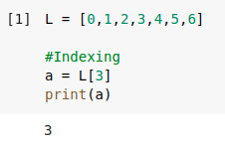

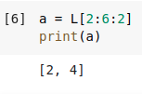
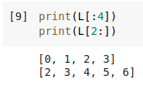
Splicing
We know that we can extract a single element from a list or string.
Splicing is a type of indexing where we can get a chunk of a list or string.
The syntax follows name[start:end:step] where the set of indices to extract are the same as if you got them from range.
If only start is specified with a colon to the right, Python will splice the whole list upto that index. Similarly, if end is specified with a colon to the left, Python will splice the whole list starting at that index.
Notes:
Show the concept of lists, and show an example.

Slide 43
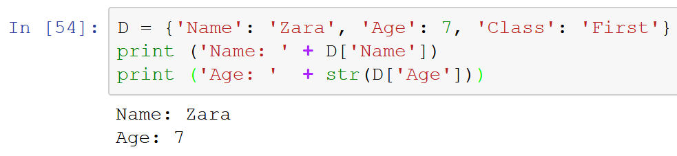
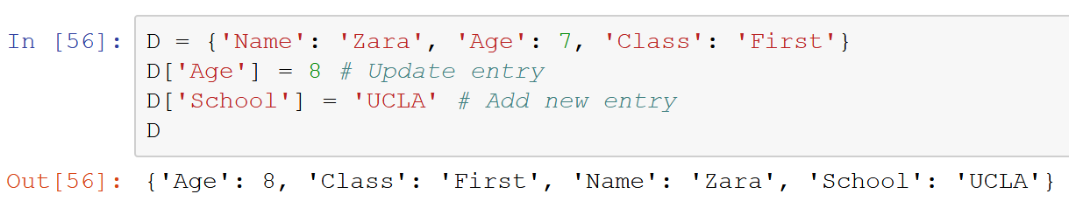
Python Types: Dictionaries
Dictionaries:
Represents a set of key-value pairs where keys are unique (i.e. numbers, strings) but values need not be. It’s not ordered.
Example:
Updating a dictionary
Notes:
Show the concept of lists, and show an example.

Slide 44
Exercise # 3
Go to Exercise 3 section in your Jupyter Notebook
Given two dictionaries, D and E, do the following:
Add John's and Tom's surnames with "Surname" as a key. (You choose the surname)
Change John's city to NY.
Create a list F with both dictionaries as it's elements.
Print out the age of the first person on the list F.
Look at https://www.programiz.com/python-programming/methods/dictionary for various methods available for dictionary data type

Slide 45
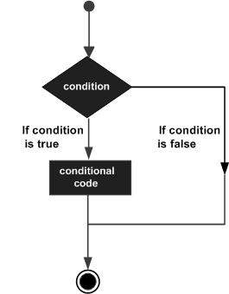
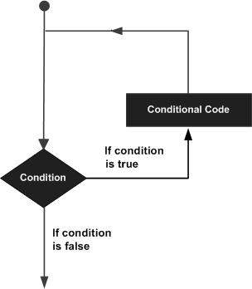
Beyond Sequential Execution: Control Flow Tools
Programming languages provide various control structures that allow for more complicated execution paths instead of just sequential
Make decisions on what to do dynamically while the program runs!
If…then
Loop
Ref: http://www.tutorialspoint.com/

Slide 46
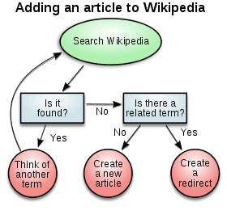
Python Basics: Decision Making
Decision Making:
Conditional constructs are used to incorporate decision making into programs.
The result of this decision making determines the sequence in which a program will execute instructions.
Notes:
Decision making can be regarded as the mental processes resulting in the selection of a course of action among several alternative scenarios. Every decision making process produces a final choice. The output can be an action or an opinion of choice.

Slide 47
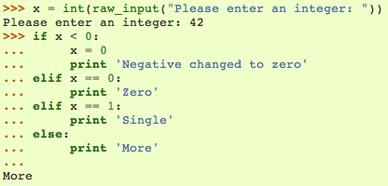
Python Basics: Decision Making
if Statement
The if statement contains a logical expression using which data is compared, and a decision is made based on the result of the comparison.
Example:
In this example, we input integer 42, which is not less than 0, not equal to 0, and not equal to 1. Therefore, it falls into the option that “print ‘More’”.
Any non-zero and non-null values are treated as TRUE by Python
Notes:
Show the concept of if statement, and show an example.

Slide 48
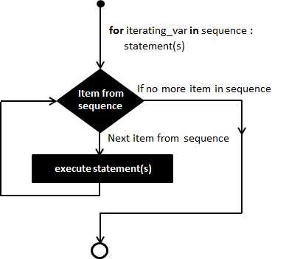
Python Basics: Looping
for statement
The for loop in Python has the ability to iterate over the items of any sequence, such as a list, tuple, or a string.
Ref: http://www.tutorialspoint.com/
Notes:
Show the concept of for statement, and show an example.

Slide 49
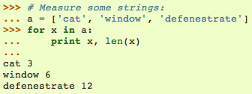
Python Basics: Looping
for statement
The for loop in Python has the ability to iterate over the items of any sequence, such as a list or a string.
Example:
In this example, all the items in list a get printed.
len(x) is a built-in function in Python, which returns the length of x.
In this example, x is a string, such as “cat”. len(x) returns “cat”’s length, which is 3.
Notes:
Show the concept of for statement, and show an example.

Slide 50
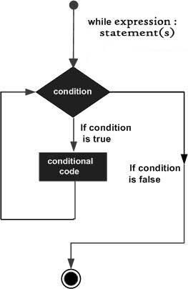
Python Basics: Looping
while statement
The while loop in Python has the ability to iterate over a statement or group of statements while a given condition is TRUE
Ref: http://www.tutorialspoint.com/
Notes:
Show the concept of for statement, and show an example.

Slide 51
Python Basics: Looping
while statement
The while loop in Python has the ability to iterate over a statement or group of statements while a given condition is TRUE
Example:
Caution: “infinite loop” if a condition never becomes false.
count = 0
while (count < 9):
print 'The count is:', count
count = count + 1
print "Good bye!"
The count is: 0
The count is: 1
The count is: 2
The count is: 3
The count is: 4
The count is: 5
The count is: 6
The count is: 7
The count is: 8
Good bye!
Ref: http://www.tutorialspoint.com/
Notes:
Show the concept of for statement, and show an example.

Slide 52
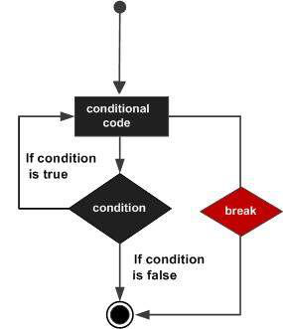
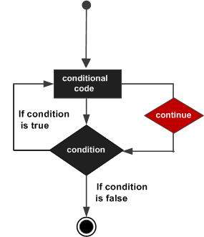
Python Basics: Loop Control Statements
for letter in 'Python':
if letter == 'h':
break
print 'Current Letter :', letter
for letter in 'Python':
if letter == 'h':
continue
print 'Current Letter :', letter
Ref: http://www.tutorialspoint.com/

Slide 53
Exercise # 4
Given the list G (of dictionaries) below, do the following:
Write a for loop that prints out all names.
Write another for loop that adds up all ages and print the sum at the end.

Slide 54
Exercise # 5
Given the list D (of integers) below, do the following:
Print only those values that are positive in the list

Slide 55
Python Basics: Functions
Defining and Calling Functions:
A function is a block of organized, reusable code that is used to perform a single, related action.
Functions provides better abstraction and modularity for your application and a high degree of code reusing
Makes your code simpler and easier to read!
Calling a function: Once the basic structure is finalized, you can execute it by calling it from another function or directly from the Python prompt.
Notes:
Reusable: In computer science and software engineering, reusability is the likelihood a segment of source code that can be used again to add new functionalities with slight or no modification.

Slide 56
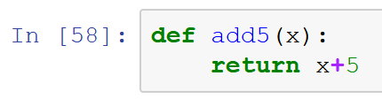
Defining Functions
By defining a function, we can put a routine into this function, and we will be able to execute this routine simply by calling this function.
For example, we introduce a function “add5”, which adds 5 onto the integer we passed into the function.
The keyword return specifies the value return by the function. Functions do not have to return a value.
Example:
In this function, x is the integer we passed into the function. And the function will return the value of x+5 back.
Notes:
Show how to define a simple function in python. This function add 5 onto the number passed into the function.

Slide 57
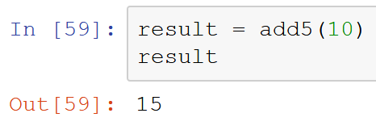
Calling the Function
To call the function add5 we just defined, we simply do:
By passing number 10 into the add5 function, 5 is added.
The result then equals to 15.
Notes:
Show how to use the function by example.

Slide 58
Exercise # 6
Write a function that does the following things:
The function takes a number x into the function.
In the function, deduct 10 from x.
If the result of the deduction is greater than equal to 0, the function returns 1.
If the result of the deduction is less than 0, the function return 0.

Slide 59
Recap with an Abstract View of a Computer
Processor
(executes steps in program)
Memory
(stores progress of program)
>>> welcomeString = “Hello World”
>>> eliteFloat = 1337 - 0.00001
>>> fullName = [“Mark, “Gottscho”]
>>> if fullName[1] == “Gottscho”:
... uni = “UCLA”
... else:
... uni = “unknown”
...
>>> website = “www.google.com”
>>> print welcomeString
Hello World
>>> print “Searching on “ + website + “ is useful!”
Searching on www.google.com is useful!
>>> print str(eliteFloat) + “ is close to 1337”
1336.99999 is close to 1337
>>> negativeInt = -28
>>> if negativeInt < 0:
... print “< 0”
...
< 0
>>> my_numbers = [1, 2, 3, 4, 5]
>>> for i in range(0,5):
... print my_numbers[i]
...
1
2
3
4
5
>>> negativeInt = -1
>>>
Location | Variable Name | Value
0 | welcomeString | “Hello World”
1
2 | eliteFloat | 1336.99999
3 | my_numbers | [1, 2, 3, 4, 5]
4 | fullName | [“Mark”, “Gottscho”]
5 | uni | “UCLA"
6 |  | -28
7 | website | “www.google.com”
8 | negativeInt | -1

Slide 60
Python Modules and Namespaces
A module is a file consisting of Python code which can define functions, variables etc.
The code for a module named mname normally resides in the file mname.py which is searched for in selected folders on the computer
Any Python source file can be used as as a module by executing an import statement in some other Python source file.
To prevent confusion with same variable and function names being used in different modules, they belong to a module’s namespace which is a dictionary of variable names (keys) and their corresponding objects (values).
Each function has its own local namespace, and a Python statement can directly access variables in the local namespace and in a global namespace.
# file: support.py
def print_func( par ):
print("Hello : ", par)
return
# some other file
import support
# Now one can call function defined in that module as follows
support.print_func("Zara")

Slide 61
Interacting with the External World (Users, Files, Computers on the Internet …)
Printing to the Screen
Reading Keyboard Input: input([prompt])
Reading and Writing Files
>>> print("Python is really a great language,", "isn't it?”)
Python is really a great language, isn't it?
# file.py
str = input("Enter your input: ");
print("Received input is : ", str)
Enter your input: Hello Python
Received input is : Hello Python
#!/usr/bin/python
# Open a file
fo = open("foo.txt", "wb")
fo.write( "Python is a great language.\nYeah its great!!\n");
# Close opend file
fo.close()
#!/usr/bin/python
# Open a file
fo = open("foo.txt", "r+")
str = fo.read(10);
print("Read String is : ", str)
# Close opend file
fo.close()
Ref: http://www.tutorialspoint.com/

Slide 62
Interacting with the External World (Users, Files, Computers on the Internet …)
Reading from Web Servers using urllib module
import urllib.request
def wget(url):
try:
with urllib.request.urlopen(url) as response
html = response.read().decode(response.headers.get_content_charset())
except IOError:
print('problem reading url:', url)

Slide 63
Exercise # 7
Write code that does the following things:
Takes a raw input string and request for a number
Check if input string is a number
Convert input string to int
Use python’s intrinsic math library to get the square root of the input number.
Look at https://docs.python.org/3/library/math.html for information on python’s math library
Look at https://docs.python.org/3/library/stdtypes.html#string-methods for string functions

Slide 64
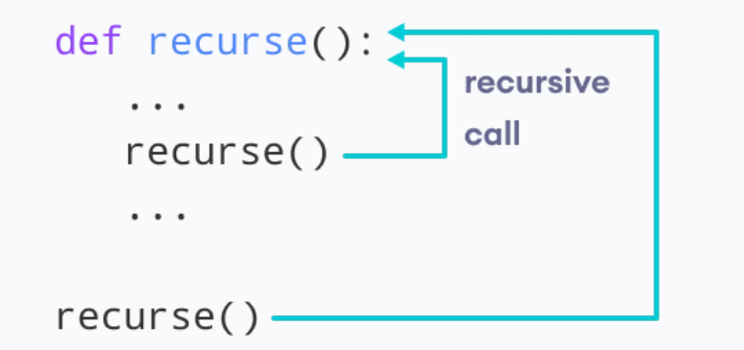
Recursion
A complex task can be broken down into simpler sub-tasks using recursion functions
Recursion functions are expensive and hard to debug
Example:
Fibonacci: 0, 1, 1, 2, 3, 5, 8, 13, 21, 34, ...

Slide 65
Recursion
# Function for nth Fibonacci number
def Fibonacci(n):
if n<= 0:
print("Incorrect input")
# First Fibonacci number is 0
elif n == 1:
return 0
# Second Fibonacci number is 1
elif n == 2:
return 1
else:
return Fibonacci(n-1)+Fibonacci(n-2)
print(Fibonacci(0))

Slide 66
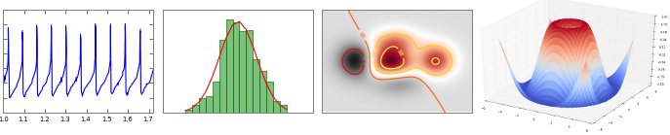
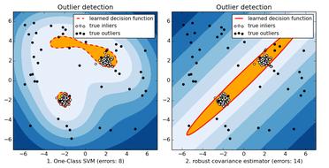
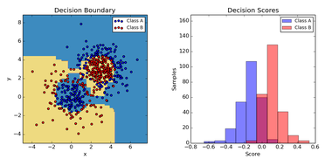
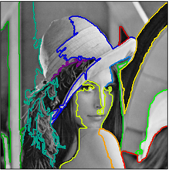
Some Very Useful Python Modules
matplotlib: a python 2D plotting library
NumPy: computing with n-dimensional arrays
SciPy: numerical integration and optimization
Sympy: symbolic mathematics
scikit-learn: data mining and machine learning
pygame, pyget: games
and many many more…

Slide 67
Assignment #1: English Word to Pig Latin Translator
Pig Latin is a language game, where you move the first letter of the word to the end and add "ay." So "Python" becomes "ythonpay."
Write a program in Assignment 1 section in jupyter notebook, which when run will prompt the user with the phrase “Enter a word:”, and then output the word entered by the user translated into Pig Latin in lowercase unless the user’s entry is empty, non-alphabetical, or has multiple word in which case the output should be “Error: incorrect input”.
Hint: break into your code into separate functions for getting user input, validating the input, translating it into Pig Latin etc.

Slide 68
Assignment #2: Compute Statistics
Mean, mode, and median are three common statistics of a set of numbers.
Write a program in Assignment 2 section in jupyter notebook, which when run will prompt the user with the phrase “Enter a comma separated list of numbers:”, and then output on three separate lines the mean, mode, and median of the entered numbers as “Mean = …”, “Mode = …” and “Median = …”. The user may enter numbers as integers or real.
Hint: Break into your code into separate functions for getting user input, computing mean, computing mode, computing median etc. Consider using the function input() instead of raw_input()- look up on the web as to how it works.

Slide 69
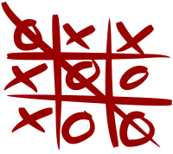
Assignment #3: Tic-Tac-Toe
Tic-tac-toe is a two player game played over a 3 by 3 grid where players taking turns making the spaces on the grid and the first play to place 3 of their marks in a diagonal, horizontal, or vertical row is the winner.
Write a program in Assignment 3 section in jupyter notebook, which will start a game of tic-tac-toe and print out the initial 3 by 3 board. It will then prompt a player to provide the location of their mark. By default, the first player will always put “X”. After every valid player input, the board is updated and printed. Make sure to check that a player’s move is valid otherwise the player has to make another input. This continues until either the game reaches a stalemate or one player is the winner.
Hint: Which data type would you use to store the board?

Slide 70
Extra Assignment : Frequency Analysis of Documents on the Web
The relative frequencies (i.e. fractions of the total) of different letters in a document are very useful for a variety of purposes, such as compressing the document, encrypting it etc.
Write a program which when run will prompt the user with the phrase “Enter a URL:”, analyze the text at the URL, and then output a sorted (highest to lowest) listing of different English (a-z, A-Z) and numeric (0-9) characters and their respective fraction of the total one per line in the format “character fraction”. Count upper and lowercase versions of a character to be equivalent, and ignore any characters other that a-z, A-Z, 0-9. Print “Error reading URL” if the URL is not reachable or if it returns data of type other than something that starts with “text/”.
Hint: what data type would you use?

